Slide 1
Getting Out of the Box
Hilary Laskey, LCSW-C
St. Mary’s County Department of Social Services, Maryland

Slide 2
What puts or keeps you in the box?
Conflicting demands
Billable hours
Insurance criteria/requirements
Client needs
Paperwork/documentation
Supervision
Meetings (internal/external)
Agency expectations
Accountability
Lack of staff
Lack of resources
Isolation
Lack of growth opportunities/training
Regulations (federal, state, etc)
Who sets the limits?
Who controls your day to day?
What do you wish you could do?
What can you do?

Slide 3
If you are a supervisor?
Challenges
Conflicts are similar to supervisee’s but also include:
Accountability for/to the agency higher management
Multiple worker needs to manage/support/balance
Isolation
Sandwich feeling

Slide 4
If you don’t find a way out, what happens?
Disillusionment
Burnout
Poor decision making
Boundary violations

Slide 5
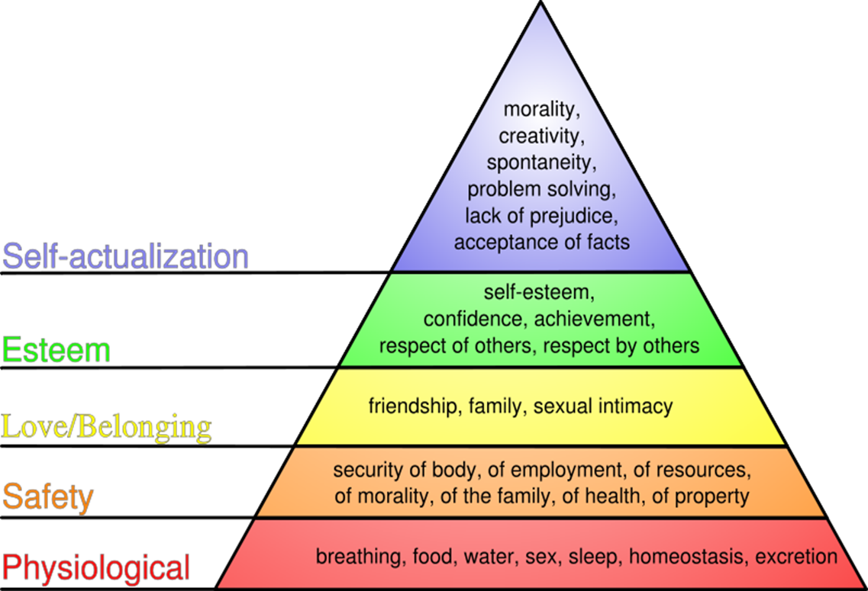
Maslow’s Hierarchy of Needs
Notes:
Child welfare is not just a family issue
Community stability is key
Poor, socially disorganized or isolated family at risk
Sense of isolation is a distinguishing factor
Loss of capacity for social control
Problem of economic instability

Slide 6
What services do we provide to our customers?

Slide 7
An Integrated Approach to Self-Sufficiency
The services we provide occur in a
multi-dimensional environment.
Individuals are assisted in
their families and in the
community in which
they live.
Invest in all three.
Teaming process can mirror
this – specific need expanded
to geo team services.
Community
Family/
Geo Team
Individual/
Program

Slide 8
Director
Assistant Director for Services
Assistant Director of Operations
Team Leaders
Leonardtown
Lexington Park
Team Staff
Child Welfare
Protective Services
Family Services
Family Investment
Child Support
Employment Training
Program Specialist
for
Child Protective Services
Family Services
Special Services
Foster Care
Program Specialist
for
Child Support
Family Investment
TCA
Employment Training
Accountability
Program Integrity

Slide 9
Teaming
Is the engine of organizational learning which encompasses multiple areas of expertise and engages in a variety of activities & expands knowledge and expertise
Crucial learning activities take place within smaller, focused units of action for organizations to improve and innovate
Teaming is an essential aspect of PQI process/way of trying new ideas & practices to move an individual or family forward

Slide 10
What teams are we a part of?

Slide 11
What Teams are we part of?
Program Teams (CPS, TCA)
Divisional Teams (Family Investment, Child Support Enforcement)
Geo Teams (Leonardtown, Lexington Park)
DSS (St. Mary’s County)
Community (St. Mary’s County)
State (Maryland)

Slide 12
Team - Noun or Verb?
Noun – physically located in same place & learn to interact, develop trust and knowledge of one another’s roles
Verb – dynamic activity of coordinating & collaborating; still need to be able to share crucial knowledge quickly, ask questions clearly and frequently
Geo Team
Staffing/Teaming

Slide 13
St. Mary’s County Department of Social Services
Vision: We envision a St. Mary’s County of healthy communities in which individuals and families are safe and thriving.
Mission: St. Mary’s County Department of Social Services, in conjunction with our community partners, is dedicated to empowering and protecting individuals and families as they seek stability and self-sufficiency.
Notes:
How do we support a person who comes to us not just to be self-sufficient but to be a better parent?
How do we ensure our customers have adequate health care and are contributing members of the community?
How do we build capacity in our customers, agency and community?
The role of human service professional is not to save the individual in poverty, but rather to offer a support system, role models and opportunities to learn, which will increase the likelihood of the person’s success. Financial resources alone are not the answer. Those who work with the poor must teach the differences, skills/rules that will allow the individual to make the choice. Ultimately, the choice always belongs to the individual.

Slide 14
St. Mary’s County Department of Social Services
Workplace Values: The SMCDSS staff believes in:
Responsibility & Accountability – essential to the creation and maintenance of trusting and productive relationships.
Communication –essential for open and continuous sharing of knowledge, the work we do, and the results we achieve.
Teaming – an interdisciplinary way of doing business based on knowledge sharing, mutual ownership and collaborative decision-making
Respect – as a positive behavior we display and promote in our interactions with others
Excellence – essential as the standard against we measure ourselves.
Empowerment – as the outcome of a process that develops skills, provides support and creates opportunities for self-improvement and self-sufficiency
Notes:
We use the word team all the time assuming everyone knows what we mean
It is in fact one of our workplace values
And the workplace behaviors expected are defined
although all workplace contain elements of the teaming concept

Slide 15
Workplace Behaviors
Organizational Value: Teaming
Behaviors:
Supporting colleagues – having each other’s backs
Sharing program knowledge
Respecting the program knowledge and practice of others
Being inclusive
Acting as part of the whole
Collaboration
Share problems and successes
Accepting the “big” picture and acting that way
Ability and willingness to adapt and change
Notes:
Mutual responsibility is a big key to the process

Slide 16
What are the barriers to Teaming?
“Siloing” is still very hard to break since it is a construct of the larger hierarchy (DHR)
People are hired for specific jobs and trained in the aspects of these roles/ often little time taken or available to learn the rest of the organization
Specific expectations/targets of each of program is presented as the goal
What are the performance measures for FI, CSE, TCA/ETC, CPS, FC, AS, FS, Finance, HR?

Slide 17
21st Century Teaming
Less feasible to have static teams – coordination & collaboration are still essential but need to be fluid, which means “teaming” needs to be about reaching out, getting up to speed, establishing who is on the team and what they bring and try to make progress, all without a blueprint
Learning & execution occur simultaneously
Skills required:
Interpersonal awareness
Skillful inquiry
Ability to teach others what you know

Slide 18
21st Century Teaming
Interpersonal dynamics can affect teaming as most problems cannot be solved without cross-disciplinary collaboration
This requires that individual participants recognize the interdependency of their roles
Leading naturally to early & constant communication among separate programs though joint work – reflection and feedback must take place once the task is completed (can be brief but must occur)

Slide 19
21st Century Teaming
People need to speak up and to make this possible, it must be understood that failure is an option
Failure will happen in a dynamic, unpredictable and ambiguous world; it is not the goal but does occur
It takes courage to be direct, hold high expectations and to understand that uncertainty and risk are part of the work so failure does occasionally happen

Slide 20
Learning through Teaming
There is a built in tension between learning and performance along with a natural relationship – to maintain or improve performance, learning is required
Group dynamics affect organization’s ability to learn – interpersonal fear has debilitating affects on the collective learning process
Learning is:
Process of action;
Reflection; and
New (often modified) action

Slide 21
Learning through Teaming
This promotes performance in 2 fundamental ways:
Learning helps people develop skills and acquire knowledge
Relative performance/Gap filling – improving performance by acquiring necessary skills or knowledge to do what others already know how to do
Notes:
1 is like learning to ride a bike

Slide 22
Learning through Teaming
Learning occurs in reaction to changes in the world that require brand new responses
Promotes performance by discovering and inventing new ways to respond that improve performance in some endeavor – no role models
Learning is paving new ground, often through trial and error
Performance is improved by better fit between capabilities and environment’s demands

Slide 23
Learning through Teaming
Learning is messy – there is no instruction manual & usually performance gains won’t show immediately
There is no guarantee that the learning is the right kind
A transition process is required
Performance may worsen on the way to improving
Trial and error does not look like good performance
Notes:
Learning process involves facing problems, mistakes (failures) head on – might not signal high performance to observers
Learning can be defined as detection & correction of errors, so in the short term, performance will appear to weaken while learning is occurring

Slide 24
Learning through Teaming
Organizational learning
Process of cascading team learning activities independently carried out but interdependent on organizational performance

Slide 25
Challenges to Teaming
When focus is on ‘becoming a team’
Struggle or resistance to taking a risk in submitting final result to a group process rather than individual (inbred reaction)
People/roles become more important than the process
Too much focus on the “what”

Slide 26
How to succeed
Focus shift to performance, goal becomes end product; team is means, not the end
Commitment of team is on their common purpose
Performance ethic becomes the culture
Members commitment to one another’s growth & development as well as the end product
Individual & mutual accountability
Focus on the “how” – method instead of results
Notes:
Performance ethic becomes culture through disciplined action, shaped by a common purpose, agreement on performance goals, definition of a common working approach, development of high levels of complementary skills and hold themselves mutually accountable for results
Best working groups come together to share information, perspectives and insights, to make decisions that help each person do his or her own job better and to reinforce each other’s individual performance standards

Slide 27
Three Pillars of a Teaming Culture
An innovative organization has a teaming culture
Teaming is an expectation
It evolves through:
Curiosity – drives people to find out what others know, bring to the table and what they can add
Passion – fuels enthusiasm and effort; care enough to stretch, go all out
Empathy – ability to see another’s perspective which is crucial to effective collaboration under pressure

Slide 28
Develop “team” for Teaming
Team Leader
FI
Customer
Services Intake
FI PS
Services PS
CSE
Community Partners

Slide 29
Teaming Process
Identify issue/concern
Identify who should be involved from other programs
Staff the case
Identify potential solutions
Implement
Identify barriers/challenges and review history
Re-evaluate for efficacy
Assign responsibilities for carrying out the tasks
Notes:
This is not necessarily a lengthy process at all

Slide 30
Case Studies
4
3
Rita
82
Susie
64
Matty
40
Nat
41
Nancy
25
Walter
32
Mike
38
Buddy
46
Dan
39
Michelle
8
Ryley
6
Junior
9
Slick
2
Wally
3

Slide 31
Scenerios
Mom Nancy 25 Boyfriend Dan 39
Children – ‘Slick’ (boy) 2; Wally (boy) 3 [Father Walter – 32]; Ryley (girl) 6; Michelle (girl) 8 [Father Mike – 38]; Junior (boy) 9 [Father “Buddy” - 46]
Live with Rita – 82, great-grandmother with diabetes & high blood pressure (bed-ridden) and Susie – 64, grandmother with COPD & obesity - live in a 3 bedroom house with a housing subsidy under Rita’s & Susie’s names – Nancy is also on the voucher with her children. Occasionally in the home are Matty (40), Rita’s grandson who uses drugs/drinks and has criminal history and Susie’s son/Nancy’s uncle Nat (41) who has the same issues – they often hang together
FS/MA application
Basic info – assistance in getting food & no health insurance
Additional info – job loss recently, 9 yr old having trouble in school which led to job loss, potential housing concerns
CPS referral - can come from variety of sources – school, dr’s, hospital, therapist, neighbor, family
Basic info – neglect – children going to school dirty/hungry
Additional info – DV situation w/current boyfriend, mom never graduated school, hx of CPS as child
CSE intake
Basic info – seeking support from ex-boyfriend/father of 2 children
Additional info – living w/relatives w/SA issues, several young children in home, mom overwhelmed/depressed
EA application
Basic info – utility shut-off (2nd notice from SMECO)
Additional info – housing could be lost due to utility, caring for disabled relative, currently working w/in-home services due to CPS investigation

Slide 32
Resources
Amy Edmondson – Economist at Harvard Business School “Teaming: How Organizations Learn , Innovate and Compete in the Knowledge Economy” & articles in Working Knowledge
The Wisdom of Teams – Jon R. Katzenbach and Douglas K. Smith
The Team Handbook – Peter R. Scholtes
Seamless Government – Russell M. Linden

Slide 33
Hilary Laskey, LCSW-C
Assistant Director - QA
St. Mary’s County Department of Social Services
Leonardtown, MD
240/725-5761
hilary.laskey@maryland.gov

