Slide 1

Building Stronger, Healthier Communities through Integrated Primary Care:
The Community Care Team
Brooke A. Griffiths, MSW, LSW
Franklin Ortiz, MSW, LCSW
Kay Ellen Werhun, DNP, MBA, RN, NE-BC

Slide 4
Disclosure
The speakers involved in this presentation have no financial relationships to disclose.
The presenters will not discuss off label use and /or investigational use in this presentation.

Slide 5
Objectives
Participants will be able to identify the benefits of a multi-disciplinary, team-based, integrated approach to health care delivery in the primary care setting.
Participants will be able to describe the Community Care Team (CCT) model and identify ways in which this model successfully meets patients’ physical, socioeconomic, and psychosocial needs in a continuous, comprehensive, and integrative way.
Participants will be able to identify the ways in which the CCT model contributes to building a stronger, healthier community while restoring patients’ hope in the healthcare system.

Slide 6

Triple Aim
Better care of individuals
Better health for populations
Reduced costs
      Donald Berwick, MD

Slide 7


Accountable Care
Notes:
Clinical integration + Fiscal responsibility

Slide 8
New Era Competencies
Engage patients: robust care management
Form effective teams for care delivery
Coordinate care across settings
Build in quality, reduce “waste”
Create & sustain community partnerships
Develop IT tools, utilize patient data sets
Focus on health of population, not just disease
Notes:
Our costliest 1% of patients account for 19% of total cost. Conversely, the least costly 50% of patients account for only 3% of costs.In order to move from a disease-focused model of care to one of promoting health, several changes are needed: newer ways of working together, critically evaluating the processes of care delivery and getting rid of waste, using information technology to help guide our clinical care across settings and learning to focus on health, not just disease.

Slide 9
Background
Utilization of LVHN IP Services Per 1,000 65+ Population
400
350
500 additional beds
$600,000,000 construction cost
300
165 additional beds
$198 million construction cost
250
200
150
100
Reducing IP utilization 3% - 5%/year =
no new beds for 65+ patients
50
0
CY00
CY30
CY01
CY02
CY03
CY04
CY05
CY06
CY07
CY08
CY09
CY10
CY11
CY12
CY13
CY14
CY15
CY16
CY17
CY18
CY19
CY20
CY21
CY22
CY23
CY24
CY25
CY26
CY27
CY28
CY29

Slide 10
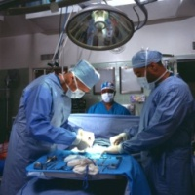
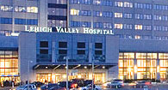


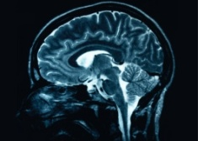

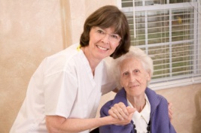
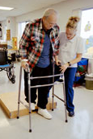

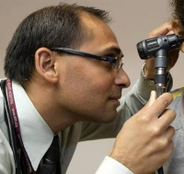

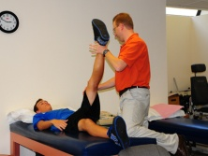


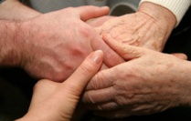
The LVHN Care Continuum
Ambulatory & Community Care
Acute Care
Ambulatory Procedure Center
Tertiary/Quaternary and Community Hospitals
Specialist Care
TeleHealth
(Primary Care thru Home Health)
Diagnostics, Imaging,
OP Rehab
Post-Acute Care
Express
CARE
IP Rehab
*Not LVHN
TSU or External SNF
Wellness, Fitness &
Education
LVHN OP Rehab
PCMH &
CCT
Initiatives
LVHN
Hospice
Primary Care
Offices & Clinics
Preventive Care @
Home
LVHN Home Health
Services
OACIS
Notes:
As we focused on the health of our communities, we learned that we needed to do a better job of coordinating and managing care across a broad continuum. Integrating services designed to meet the needs of specific groups as they go from the hospital to the rehab center to home is one of the goals of building “Healthier Communities”—one of our network’s priorities. We’ve also instituted programs like OACIS. OACIS is a palliative care approach for patients with serious chronic medical illnesses. Patients & their families work with the clinical team to design care that is consistent with the patient’s goals, whether they are in the hospital, in their home or in a supervised living arrangement.
While family medicine and primary care have long been integral to chronic illness care and prevention, it has had to morph from the “Marcus Welby” era to a new era where the primary care “Medical Home” has had to be more things to more people. In other words, the house has needed a makeover. Higher volumes in recent years has led to deterioration in access, Increased fragmentation, reduced patient and clinician satisfaction, overutilization and increased health care costs.

Slide 11


Department of Vermont Health Access
Hospitals
  A foundation of medical homes and community health teams that can support coordinated care and linkages with a broad range of services
  Multi Insurer Payment Reform that supports a foundation of medical homes and community health teams
  A health information infrastructure that includes EMRs, hospital data sources, a health information exchange network, and a centralized registry
  An evaluation infrastructure that uses routinely collected data to support services, guide quality improvement, and determine program impact
Specialty Care & Disease Management Programs
Advanced Primary Care
Community Health Team
Nurse Coordinator
Social Workers
MH/SA Clinician
Nutrition Specialists
Community Health Workers
MCAID Care Coordinators
SASH Teams
Public Health Specialist
Advanced Primary Care
Social, Economic, & Community Services
Mental Health & Substance Abuse Programs
Advanced Primary Care
Advanced Primary Care
Healthier Living Workshops
Public Health Programs & Services
Health IT Framework
Evaluation Framework
3/12/2015
3/12/2015
11
11
Notes:
3/12/2015
11
11

Slide 12
The Journey…
Primary Care Development Task Force
  Developed a comprehensive Strategic Plan for Primary Care at LVHN
LVHN owned and aligned practices participated in Learning Collaboratives
  2009 Pennsylvania Chronic Care Initiative
  2010 Pennsylvania Resident Physician Collaborative
  2010 LVHN Primary Care Collaborative
Notes:
2009 Pennsylvania Chronic Care Initiative: Designed as a multi-stakeholder implementation of the Chronic Care Model and aligned with the Patient Centered Medical Home. Seven practices from LVHN were included in the South Central PA collaborative of this program, and received enhanced reimbursement based on the introduction of care management into practices and attainment of Level III Patient Centered Medical Home recognition by the NCQA. To date they have received a combined total of just over $1million over three years. This collaborative was completed in February 2012 due to lack of continued multi-payer support in our region. All seven LVHN practices achieved NCQA Level III Recognition.
2010 Pennsylvania Resident Physician Collaborative: Three resident-based practices have participated in this collaborative sponsored by the Pennsylvania Academy of Family Practice since 2010. This collaborative has focused on growing PCMH in resident training, thereby increasing resident knowledge, skills, attitudes and interest in enhanced primary care practice. The LVH Family Health Center has achieved NCQA Level III Recognition.
2010 LVHN Primary Care Collaborative: 18 additional practices have completed one year as part of the LVHN Primary Care Collaborative, supported by the LVPHO. Participants were instructed at the onset to identify areas for improvement within their practices, and with coaching from SPPI using LEAN methodology, develop A3 plans to measurably improve process and clinical outcomes. While many challenges remain for these practices, each has demonstrated some degree of improvement consistent with the overall goals of patient-centered care. This collaborative incorporates the experiences of the previous two groups, and also focuses on evidence-based pillars of primary care that have been demonstrated to improve primary care’s goal of better population health at lower cost.

Slide 13
Aspirations
Transform primary care
Deploy Community Care Teams
Support, promote, and implement innovative and successful models of primary care
Develop standard collaborative agreements
Manage fiscal status while navigating the unpredictable policy landscape
Notes:
Transform primary care to better serve our community by way of coordination of care across the care continuum, improved information flow, infrastructure development and integration, and education to our community on the importance of wellness, prevention, and chronic illness management.
Deploy Community Care Teams to support primary care practices in improving care for patients of our community
Support, promote, and implement innovative and successful models of primary care such that fifty percent of LVHN patients received their care in an NCQA-recognized PCMH by 2016.
Develop standard collaborative agreements between primary care practices and specialty practices in order to facilitate sharing of information and accountability of care.
Manage fiscal status while navigating the unpredictable policy landscape

Slide 14
LVHN Integrated Care Management Model
Community Care Teams
Super Utilizers
Clinical Management Guidelines
Integrated Ambulatory Care Manager
Care Transitions
Registry Maintenance
PCMH
Guiding Principles
Primary Care Management
Pre-Visit Planning & Standard work for Acute Non-Urgent, Emergent, and Preventative Care
Preventative Care
EPIC Portal Engagement
E-Learning and Telephonic Reminders

Slide 15






Practice
Practice
CC
Soc. Worker
Soc. Worker
CC
RN Care Manager
Practice Coach
RN Care Manager
_{Practice}
Practice
CC
CC
Community Care Team 1
IT Support
Community Care Team 2
Clin
Pharm
CC
Beh. Health
Beh. Health
CC
Practice
Practice

Slide 16
Care Coordination
Definition: A generic term for the integration of health and social care services for a particular person.
Components of Care Coordination
  Working with an individual and his/her caregiver(s) to ensure that a high-level, integrated and personalized care plan is implemented
  Monitoring services to ensure they are delivered effectively on time and achieve their objectives
  Facilitating communication between multiple agencies and professionals, and overseeing discussions/meetings as appropriate
  Maintaining contact with the individual during hospital stay and arranging for discharge
  Ensuring that reviews of care are undertaken

Slide 17
Goals of Care Coordination
Improve the overall health of the population under their care
Create a more satisfying experience of care
Reduce the costs to deliver that care

Slide 18
Community Care Teams
Who We Are
Starting in July 2012
  RN – Care Managers
  Social Services
  Behavioral Health
  Pharmacist
Serve 24 Primary Care Practices
Covering: Lehigh, Northampton, Berks, Carbon & Monroe Counties

Slide 19
What We Do
The community care team members facilitate the care coordination, social, behavioral health, and education needs of the high risk patient population (5%)
CCTs coordinate and connect patients to additional healthcare and community resources in order to support their health improvement goals, achieve better health outcomes and reduce avoidable costs
Notes:
those with complex or chronic conditions
Limited support system
Limited resources

Slide 20
High Risk Population
Patients who are typically at greatest risk for medical problems based on qualifying factors
A population segment that would benefit from additional utilization management resources
Notes:
Multiple readmissions
Clinical indicators
Chronic conditions
Multiple medications
Insurance complications

Slide 21
High Risk Registry
Purpose is to provide a registry of patients within our practices that may be at greatest risk for medical problems
Notes:
This registry exits on HBI
Providers are encouraged to review the registry prior to the CCT members beginning work in their practice
Suggested to begin with 5 – 10 highest risk patients for management and allow for growth from that point

Slide 22
High Risk Registry Qualifiers
Clinical Indicators
Chronic Conditions
Multiple Medications
Inpatient/ED visits
Insurance
Additional Criteria for consideration:
  Urgent housing need
  Grief
  Recent Crisis
  Request for services in home, financial issues, no support system
Notes:
To help better define the population served, a list of criteria was developed. Patients will automatically be listed as high risk based on the following:
3 or more of the following allow for enlistment on the registry
Clinical indicators – 3 or more from indicator list
Chronic conditions – 3 or more from list – mental health criteria counts as 1 contribution
Multiple Medication – 6 or more prescribed meds
Inpatient or ER two times within the past 6 months
Insurance: Medicare, Medicaid, or Self Pay as primary
Add’l Criteria: Homeless/urgent housing need – SW
Grief – acute loss or event within 3 months – BH
Recent crisis or inpatient mental health admission – BH
Services in home, financial, no support - SW

Slide 23
Provider CCT Utilization
Practitioners use defined criteria to identify patients most at need for services:
  Listed on high risk registry
  Have an identified need
  Are Ready to Change
Notes:
Non –high risk referrals: are accepted however must have a demonstrated need. Resources given to practice staff to relay to patient, if ongoing
Talk about CCT referral process through CPO
Remember, this is a shared resource that is limited in capacity – please utilize for those patients who most closely fit the defined criteria, and who the provider feels will most benefit from the additional resource
Per the Maine model, the CCT is expected to serve approx 5-10% of the total patient population

Slide 24
CCT Managed Patient Goals
Improve adherence
Reduce non-essential utilization
Improved patient self management
Provide patients with direct point of contact while providing intensive, multifactorial, care management
Notes:
We are a resource here to collaborate with the practice to facilitate the management of the most complex patient

Slide 25


Slide 26

CCT Social Workers
Qualifications: BSW, MSW preferred
Caseload: 3-5 Primary Care Practices
  based on the volume of high-risk patient population
Essential duties:
  Assess the patient and their family’s needs.
  Partner with the patient, their family, and the community to develop a care plan.
  Care plan builds on patient and family’s strengths.
  Implement care plan and remove identified barriers to care.
Notes:
The inclusion of social workers to the Community Care Teams in primary care practices demonstrates the value that is being placed on assessing and addressing the socioeconomic and psychosocial variables that impact one’s health.

Slide 27
CCT Social Workers
Essential Duties:
  Partner and utilize local healthcare and community resources and supports to coordinate care.
  Provide education and resources to Primary Care Practice staff so they are able to better meet the socioeconomic and psychosocial needs of the non-high risk patients in their practices.
Notes:
The inclusion of social workers to the Community Care Teams in primary care practices demonstrates the value that is being placed on assessing and addressing the socioeconomic and psychosocial variables that impact one’s health.

Slide 28
CCT Social Workers
Common Referrals Received:
  Uninsured/Underinsured
    Medicaid, Medicare, LVHN’s FAP, Federal Marketplace
  Financial Assistance
  Cost of Medications
    PAP Tracker
    www.rxassist.org
    CCT funded Charity Medication Program
  Transportation
  Safety
  Placement/Long-Term Care
  Allied Health (PT, OT, DME, Homemaker Services, Respite)
  Lack of food/shelter/utilities
  SSD, SSI, Food Stamps, Cash Assistance, Unemployment
Notes:
The bulk of the referrals the social workers receive are for patients who are uninsured or underinsured and/or cannot afford their medications. Other common reasons for referral include: lack of financial resources, lack of transportation, unsafe in the home, in need of placement or long-term care planning, allied health services, lack of food, shelter, or utilities, assistance with SSD, SSI, public assistance programs, such as food stamps or cash assistance, and unemployment claims.

Slide 29
CCT Social Workers
Assessment:
  Completed within EPIC (EMR)
  Two parts:
    Social Services Assessment
    Financial Assessment
      All sources of income.
      All expenses.

Slide 30
CCT Social Workers
Social Services Assessment:
  Referral Source and Reason for Referral
  Primary Support Person and/or Decision Maker
  Support Services Identified
  Community Affiliations
    Faith Based, Cultural, Ethnic, Recreational, Volunteer
  Living Situation
  Advanced Directives
  Current Behavior/State of Mind
  Education and Literacy (Including Health Literacy)

Slide 31
CCT Social Workers
Social Services Assessment:
  Sources of Income
  Type of Residence
  Transportation
  Legal Concerns
  Home Safety Concerns
  Other Environmental Concerns
  Financial Concerns
  Needs Patient Identifies Needing Assistance With

Slide 32
CCT Social Workers
Social Services Assessment:
  ADL’s/IADL’s; Activity/Functional Status
  Fall Screening
  Depression Screening (PHQ2 and PHQ9)
  Abuse Indicators (Domestic Violence Screening)
  Social History:
    Tobacco Use, Alcohol Use/Abuse, Drug Use/Abuse, Sexual Risks, Socioeconomic Information, Social ADL’s
  Summary/Care Plan:
    Actions Taken, Tasks Assigned to Patient, Planned Follow Up Date, Goals and Status of Achieving Goals
    Time Spent on Contact and Time Spent on Care Coordination

Slide 33
CCT Social Workers
Patient Snap Shot: J.M.
  74 year old Caucasian male
  Monthly Income = $1080 (SS and Pension)
  Divorced; One Son; Neighbors Supportive
  Lives alone in a mobile home
  No heat, running water, or working plumbing
  Hoarder
  Enjoys selling things at flea markets in the warmer months
  Heat: small electric space heater or sleeps in his truck
  Needs eye exam/glasses and hearing aids
  Medical Conditions: Diabetes, COPD, CHF, Hypertension
  Frequent trips to the ER and inpatient hospitalizations
Notes:
J.M. is a 74 year old Caucasian male. He is retired and receives $900/month in SS and $180/month pension. He is divorced and has one son. He lives in a mobile home. At the time of referral his mobile home had no heat, no running water or working plumbing. He is a hoarder and enjoys going to flea markets during the warmer months and spending time with his neighbors. Heat source: small electric space heater or in truck, which is missing the rear window. Also in need of hearing aids and glasses. Medical conditions include: Diabetes, COPD, Hypertension, and CHF.
Care goals met so far: eye exam and glasses, hearing aids, nebulizer to give self breathing treatments at home rather than going to ER each time he feels short of breath, $500 crisis grant for propane delivery (heat), a hot and a cold meal from Meals on Wheels 5 days/week, food stamps, Medicare Part B premiums paid through county assistance office, assigned a caseworker through the Area Agency of Aging, on wait list for affordable senior housing and ready and willing to move (previously not ready, refused to move twice before), LVHN’s FAP to cover the 20% that Medicare doesn’t cover, emotional support when neighbor/best friend committed suicide, care collaboration with patient, Aging caseworker, patient’s ex-wife and his son.
Care goals that still need to be met: moving into affordable and safe housing, cleaning out/selling of mobile home, and address hoarding behaviors.
Length of engagement: One year so far.

Slide 34


Slide 35
LVHN Psychiatry
Adult and Children’s Inpatient Units
Partial Hospitalization for Adults and Adolescents.
Outpatient Psychiatric Services For Adults, Children and Adolescents
Psychiatric Consultation Liaison Services
Psychiatric Emergency Screening Services
Integrated Psychiatric Care
Integrated Behavioral Health

Slide 36
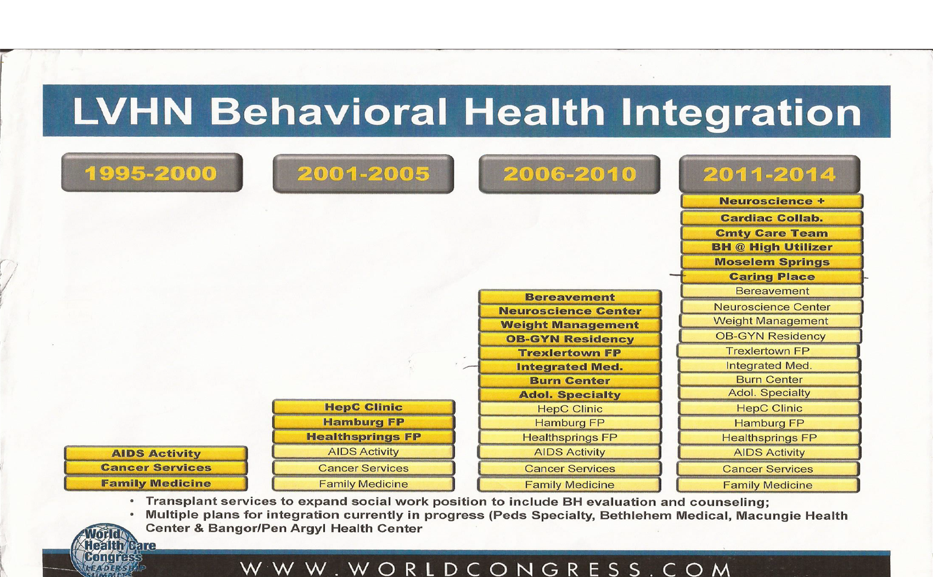

Slide 37
CCT Behavioral Health Specialist
Function as a member of the multi-disciplinary CCT working with physician practices to provide comprehensive behavioral health services across the care continuum for high-risk patients with multiple chronic conditions and Mental Health/Substance Abuse conditions
9 CCT Behavioral Health Specialists covering 24 Primary Care Practices
Perform comprehensive intake and level of care assessments and refer patients to appropriate Mental Health and Substance Abuse providers. Evaluate and identify barriers to care
CCT recently awarded grant by PA Department of Health to expand CCT Behavior Health Services
Notes:
Collaborate with PCP regarding Behavioral Health of patient and members of the CCT regarding whole patient centered care.

Slide 38
Behavioral Health Specialist
Provide short term, solution focused therapy while assisting in linkage to appropriate Mental Health/Substance Abuse providers. Act as a bridge until access has been established to outside mental health providers
Typical length of treatment is between 6-8 sessions
Facilitate Depression Screenings (PHQ-9), Anxiety Screenings (GADS) and during intake, during treatment and at discharge
Notes:
additional research suggests that up to 67% of those who attempt suicide receive medical attention as a result of their attempt
As many as 81% do not seek prior psychiatric help.
Importance of Depression Screenings and

Slide 39
Behavioral Health, Suicide and Primary Care
Up to 45% of individuals who die by suicide have visited their primary care physician within a month of their death; additional research suggests that up to 67% of those who attempt suicide receive medical attention as a result of their attempt
Recent research shows that 25-60% of people contemplating suicide seek attention for a medical problem in the weeks before death, and yet as many as 81% do not seek prior psychiatric help. Such evidence speaks to the need for systems to help identify and monitor individuals at risk for suicide in primary care settings
Am J Psychiatry. 2002 Jun;159(6):909-16.
Contact with mental health and primary care providers before suicide: a review of the evidence.
Luoma JB1, Martin CE, Pearson JL.

Slide 40
Behavioral Health in Primary Care
Mental illness is a source of significant comorbidity in the chronically ill
A substantial volume of Behavioral Health Hare is delivered in primary care settings
Given the burden of illness and the volume of behavioral health care delivered in primary care settings, emphasis on integration between behavioral health and primary care is needed
Notes:
Particularly for patients with diabetes or cardiovascular disease. Diabetes patients, for instance, are twice as likely to suffer from depression as the general population.
In 2010, approximately 23 million people ages 12-64 reported symptoms of substance use disorders, while only 11 percent received treatment at a specialty facility.
General and internal medicine physicians cared for 34 percent of patients with a primary mental health diagnosis in 2008 alone and Up to 60 % in rural areas,

Slide 41
Motivational Interviewing as a Tool
Motivational Interviewing: “A directive, client-centered counseling style for helping clients explore and resolve ambivalence about behavior change.” William R. Miller, 1991
Motivational interviewing is designed to stimulate the patient’s desire to change unhealthy behaviors
Open-ended Questions, Affirmations, Reflective Listening, and summarizing (OARS)
The counseling technique is focused, goal directed and patient centered

Slide 42
MI Continued
The emphasis is on helping the patient consider different courses of action, identify personal goals and take responsibility for his or her progress
Open-ended questions and statements of affirmation are helpful to the process
Reflecting patients’ thoughts back to them can elicit conversation and help them arrive at their own ideas for change

Slide 43
CAPTURING THE SPIRIT OF MOTIVATIONAL INTERVIEWING
Motivation to change is elicited from the patient, not imposed from outside
It is the patient’s task, not the therapists, to resolve his or her ambivalence
Direct persuasion is not an effective method for resolving ambivalence
The counseling style is a quiet one, with a focus on eliciting the patient’s thoughts
The therapist is directive in helping the patient examine and resolve ambivalence
Readiness to change is not a patient trait but a fluctuating product of interpersonal interaction
The therapeutic relationship is more like a partnership or companionship; expert/recipient roles can impede the process
For more information, visit http://www.motivationalinterview.net.
Notes:
Change Plan Worksheet, SMART GOALS, Change Plan Worksheet, SMART GOALS, Specific, Measurable, Attainable, Relevant, Time-Based.
Change Plan Worksheet
The changes I want to make (or continue making) are:
The reasons why I want to make these changes are:
The steps I plan to take in changing are:
The ways other people can help me are:
I will know that my plan is working if:
Some things that could interfere with my plan are:
What I will do if the plan isn’t working:
SMART GOALS

Slide 44
Patient Snap Shot
25 yr. old T4 Paraplegic Static Post GSW
Hospitalized more that 60 days due to discharge situation
History of mood swings, anxiety, and marijuana and benzodiazepine abuse and possible opiate medication abuse
CCT BH, CCT SW and CCT CM able to meet patient and family while in hospital
MI used to help patient set goals and take ownership of his PTSD
CCT helped refer patient to a Partial Hospitalization Program, establish his medical insurance and connected him to Center for Independent Living
Patient able to get discharged to uncles apartment until patient attained his own place
Patient has followed up with outpatient MH services and PT with new goals of participating in men’s wheelchair basketball league.
Notes:
25 yr. old T4 Paraplegic Static Post GSW, and history of mood swings, anxiety and marijuana and benzodiazepine abuse was hospitalized for more than 60 days due to discharge problems (family will not take him back). CCT able to meet with patient and family members while in hospital. MI used to help patient set goals and take ownership of his PTSD symptoms. Patient was an avid djembe drummer and loved to teach others. CCT helped refer patient to a Partial Hospitalization program, establish his medical insurance and referred him to Center for Independent Living which helped find an apartment close to his uncles house. Patient has followed up with Outpatient MH services and PT where his other new goal was to participate in a men's wheelchair basketball league.

Slide 45
Cultural Competence in Behavioral Health
Cultural competence is the ability to relate effectively to individuals from various groups and backgrounds
Cultural competence recognizes the broad scope of the dimensions that influence an individual’s personal identity
• race• ethnicity• language• sexual orientation• gender• age• disability• class/socioeconomic status• education• religious/spiritual orientation
Notes:
With the increasing diversity of the U.S. population, mental health service providers must
be aware of the influences that culture has on psychological processes, mental illnesses,
and the ways that people seek help. They must also be aware of the variety within
groups.

Slide 46
Cultural Competence in Behavioral Health
Disparities in Behavioral Health Services
Racial and ethnic minority, marginalized populations
  Less likely to have access to available Behavioral health services
  Less likely to receive necessary behavioral health care
  Often receive sub-standard quality of treatment
  Significantly underrepresented in behavioral health research
Notes:
Often misdiagnosed or over diagnosed.
Other factors such as racism, discrimination, violence, acculturation and poverty may exacerbate Mental Health

Slide 47
Cultural Competence in
Behavioral Health
Cultural Barriers to Behavioral Health Care
Mistrust and fear of treatment
Alternative ideas about what constitutes illness and health
Language barriers and ineffective communication
Access barriers, such as inadequate insurance coverage
Lack of diversity in the mental health workforce
Cultural Competency Standards into practice

Slide 48
Key Takeaways
Use open-ended questions to identify each person’s unique cultural outlook
Re-evaluate intake and assessment documentation, as well as policies and procedures, to be more inclusive
Employ qualified mental health workers who are fluent in the languages of the groups being served
Understand the cultural biases of staff and provide training to address educational needs
Notes:
· Understand the cultural biases in program design.
· Identify resources, such as natural supports, within the community that will help an
individual recover.
· Design and implement culturally sensitive treatment plans.
· Evaluate procedures and programs for cultural sensitivity and effectiveness.
· Survey clients and workers to elicit their understanding of cultural competence and
culturally competent practice

Slide 49
An Example of Cultural Competence in Practice: A Community-Based Intervention
36 year old Single, Korean Man, Deaf, Mute, does not sign and only gestures
C/O Depression and Fatigue.
CCT able to spend time with Family members to learn about this man’s life.
CCT research comprehensive resources for family
Found out patient liked to make artwork out of carved wood and encouraged family have patient make new projects.\
Patient and family very grateful due to the CCT spending time with the them. Patient responded well to change in antidepressant medication and became more active with his artwork and helping his brother at his business.
Notes:
Became deaf after receiving acupuncture treatment in Korea. Sister recently arrived from Japan with Autistic twins and overwhelmed ( She was given resources as well).

Slide 51
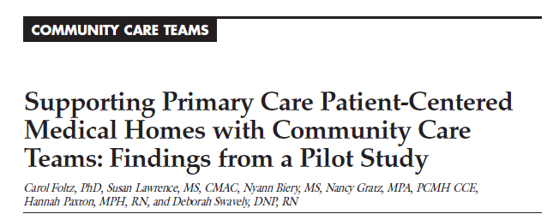

gtgg
Findings:
  Significant improvements in quality indicators for practices with and without CCTs
  Reduction in the probability of an admission/readmission for high risk patients in CCT practices only.
  Probability of unplanned admission reduced for CCT and non-CCT patients.
  Probability of readmission only reduced in CCT
  patients receiving hospital D/C call from CCT staff.

Slide 52
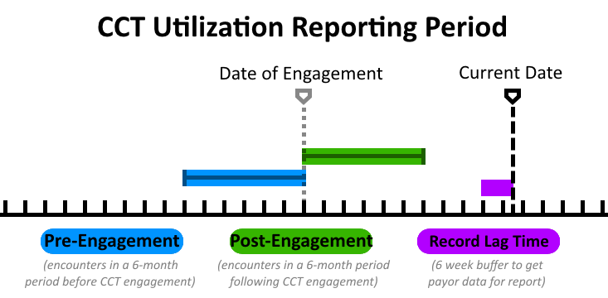
CCT Practice Data
6 Months Pre-Post CCT Intervention
July 2012-December 2014
Row Labels | Pre-Engagement | Post-Engagement | Patient Count | % Change
ABC -CV | 13 | 12 | 49 | È | 7.69%
Centro de Salud Latino Americano | 193 | 181 | 159 | È | 6.22%
Children's Clinic at LVH | 105 | 74 | 192 | È | 29.52%
Fogelsville Family Medicine | 36 | 29 | 75 | È | 19.44%
Hamburg Family Practice | 257 | 167 | 258 | È | 35.02%
Internal Medicine of LV | 1291 | 872 | 796 | È | 32.46%
Lehigh Area Medical Assoc | 114 | 68 | 100 | È | 40.35%
Lehigh Family Medicine Assoc | 590 | 460 | 503 | È | 22.03%
Lehigh Valley Internists | 88 | 66 | 50 | È | 25.00%
LV Family Health Center | 690 | 528 | 346 | È | 23.48%
LVPG General Internal Medicine | 1023 | 729 | 690 | È | 28.74%
LVPP -PCP | 998 | 818 | 575 | È | 18.04%
Muhlenberg Primary Care -MHC | 998 | 652 | 581 | È | 34.67%
Parkland Family Health Center | 187 | 116 | 131 | È | 37.97%
Pleasant Valley Family Practice | 17 | 21 | 21 | Ç | -23.53%
Trexlertown Family Medicine | 193 | 149 | 108 | È | 22.80%
Grand Total | 6793 | 4942 | 4634
CCT Reporting Data
The data used for this series includes patient encounters that meet ALL of the following conditions:
CCT Engagement must occur after 01 January 2011
Only patient encounters up to 6 months before CCT Engagement
Only patient encounters up to 6 months after CCT Engagement
There is a sliding-window of 6 weeks (42 days) before the current date in which patient encounters are excluded from reporting. During this record lag time, payer data is being processed and attached to the patient record.

Slide 53
CCT Utilization Data: All Practices
6 months Pre-Post Intervention
July 2012-December 2014
49%
25%
6%
CCT Reporting Data
The data used for this series includes patient encounters that meet ALL of the following conditions:
CCT Engagement must occur after 01 January 2011
Only patient encounters up to 6 months before CCT Engagement
Only patient encounters up to 6 months after CCT Engagement
There is a sliding-window of 6 weeks (42 days) before the current date in which patient encounters are excluded from reporting. During this record lag time, payer data is being processed and attached to the patient record.

Slide 54
Care Managers
July 2012-Feb 2015

Slide 55
Behavioral Health Specialists
July 2012-Feb 2015

Slide 56
Social Work
July 2012-Feb 2015

Slide 57
Pharmacy
July 2012-Feb 2015
N=too small
16% Increase
0% Reduction

Slide 58
CCT Pharmaceutical Assistance
Notes:
217,038

Slide 60
References
Berwick, Donald M., Nolan, Thomas W., & Whittington, John (2008). The triple aim: Care, health, and
cost. Health Affairs, 27 (3), 759-769.
Foltz, Carol, Lawrence, Susan, Biery, Nyann, Gratz, Nancy, Paxton, Hannah, & Swavely, Deborah
(2014). Supporting primary care patient-centered medical homes with community care teams:
Findings from a pilot study. Journal of Clinical Outcomes Management, 21(8), 352-361.
Goldberg, A. (2012). It matters how we define health care equity. Institute of Medicine. Washington,
D.C. http://www.iom.edu/~/media/Files/Perspectives-Files/2013/Commentaries/BPH-It-MattersHow-we-
define-Health-Equity.pdf
Miller, W.R.; Rollnick, S. , Butler, C. B. (2007). “Motivational Interviewing in Health Care: Helping Patients
Change Behavior.
Robert Graham Center (2007). The patient centered medical home: History, seven core features,
evidence, and transformational change. Center for Policy Studies in Family Medicine and Primary
Care. http://www.grahamcenter.org/online/etc/medialib/graham/documents/publications/mongraphs-
books/2007/rgcmo-medical-home.Par.0001.File.tmp/rgcmo-medical-home.pdf

Slide 61
References Cont.
Reed, J. (2008). Primary Care: A Crucial Setting for Suicide Prevention, Suicide Prevention Resource Center
Stewart, E.E; Fox, F.(2011). Encouraging Patients to Change Unhealthy Behaviors with Motivational,
Interviewing. FAMILY PRACTICE MANAGEMENT
Sobell and Sobell, ©2008 Motivational Interviewing Strategies and Techniques.

