Slide 1
Innovative Changes in NYS Ronjonette Harrison, LCSW-R

Slide 2
CROSSROADS Program
Hon. Paula L. Feroleto, 8th Judicial District Administrative Judge
Hon. Thomas Amodeo, Chief Judge
Hon. James A.W. McLeod, Presiding Judge
Empowering Court Involved Youth for a Lifetime of Success

Slide 3
Why Crossroads?
From January 2009 through December 2012, Buffalo City Court reported 19,671 young adult arrest – youth between the ages of 16-24 were arrested for lesser offenses ( non-violent felonies and misdemeanors).
January 2009 through December 2012, Erie County Family Court reported 4,243 arrest with 2,218 arrested for Type I offenses that include aggravated assaults, larceny and robbery.

Slide 4
CROSSROADS Comprehensive Strategy
for Young Adult Offenders
> Problem Behavior > Alcohol & Drug Usage > Arrest > Serious, Violent, and Chronic Offending
Engagement
Target Population: Young Adults
Graduated Sanctions
Target Population: Young Adults
Arrest/Appearance Ticket
>
Research-Based Assessment
Immediate Intervention
>
Intermediate Sanctions
>
Community Based Services
Education
&
Workforce Dev.
>
>
>
Discharge
Improving the justice system response to young adult offenders through a collaborative engagement approach that includes service providers and civil advocates in the court process
Improving the justice system response to young adult offenders through a system of graduated sanctions and a coordinated continuum of treatment alternatives

Slide 5
Number of Participants
Participant Characteristics
2009 - 203
2010 - 256
2011 – 306
2012 – 545
2013 - 681
85% had mental health diagnoses.
42% had a history of drug or alcohol abuse.
58% suffer from complex stress disorder.
90% have significant family disorganization.
Over 80% are disconnected from school or failing.
DATA

Slide 6
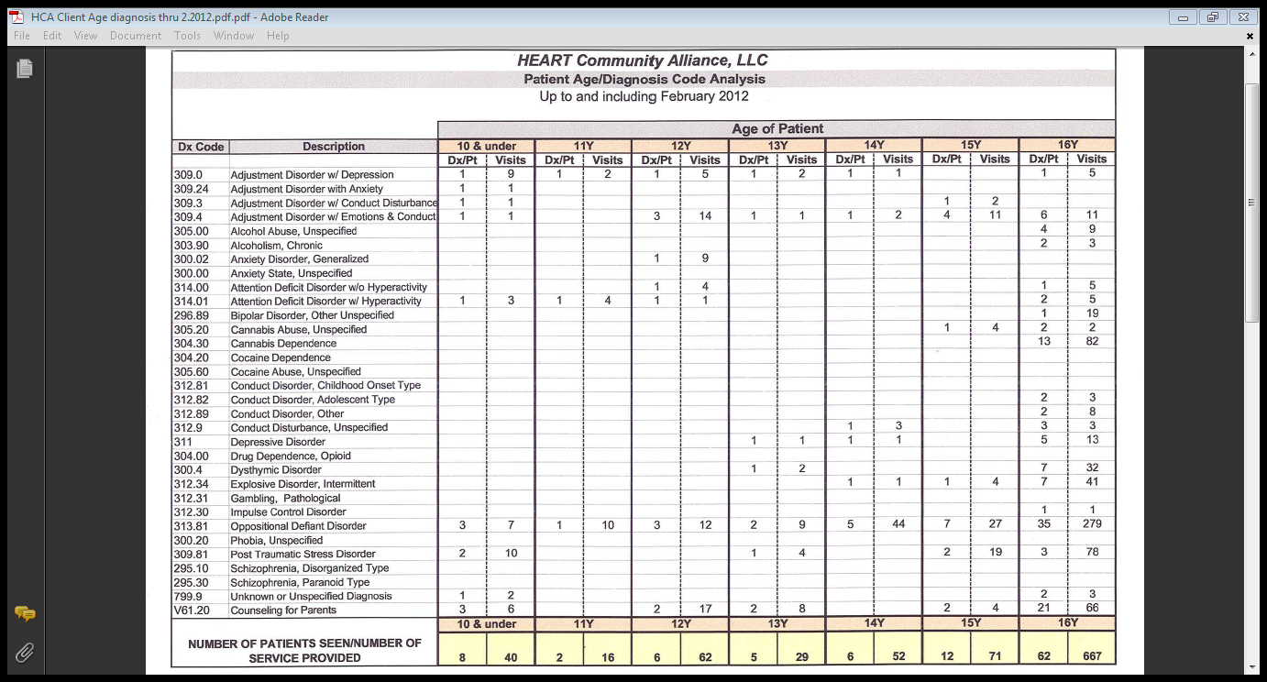

Slide 8
Multiple levels of risk affect a young person’s decision to join a gang.

Slide 9
Why is Crossroads Successful?
Research-Based Assessment Tool used to determine risk factors, needs and strengths
Access to Basic Needs
Education
Treatment
Connectivity to Family and Community
Cultural and Linguistic Sensitivity

Slide 10
Treatment Components of the HEART Model
Individual & Family Sessions
Groups (Adult and Youth)
Cognitive Behavioral Therapy
Dialectical Behavioral Therapy
Motivational Interviewing
Family Education Group
Social Support Groups
Coordinated Case Planning
Random Urine Testing
Holistic Wellness Focused
HEART

Slide 11
Crossroads utilizes “Courts Plus” to provide:
Behavioral
Management
Group Counseling
Cognitive
Behavior
Drug & Health
Education
Individual
Counseling
Academic
/ GED
Interpersonal
Skills

Slide 12
Program Principles
Individuals, especially children need to be viewed and understood within developmental framework
Individuals, especially, children are a part of families, so families need to be viewed and understood holistically
Prevention, early intervention, and treatment must be provided within a public health context, along a continuum and must address risk and protective factors
Services and supports for individuals and their families should be family-driven and individual-guided; culturally and linguistically competent; individualized and strengths-based; and community-based (person centered)
Behavioral health care needs to be comprehensive, coordinated, and integrated across multiple individual-and-family-serving systems
12

Slide 13
Major Accomplishments
CROSSROADS has produced $9,600,000 cost savings to NYS without jeopardizing public safety.1
Served 1046 clients since 2009.
Overall recidivism rates have declined from 2009 to 2010 for clients who successfully completed the program and have been out of the program for a period of six to 12 months. Clients who successfully completed the program and have been out of the program for more than 12 months show a sharper decline in recidivism rates from 2009 to 2010.
CROSSROADS created a G.E.D. program that is housed within Buffalo City Court. This is the 1st time in the history of NYS that a problem solving court has placed a GED program physically in the Court.

Slide 14
NEXT STEPS
Ensure that reentry plans are individualized and provide for seamless, well-supported transitions from facilities back to the community.
Ensure that OCFS partners and coordinates with community-based agencies providing transitioning youth access to a full range of evidence-based services and interventions.
Improve and expand the use of data and other performance measures to guide decision making, enhance accountability, and drive system improvement.

Slide 15
Ronjonette Harrison, LCSW-R @ Transformational Opportunities

