Slide 1
Institutional Trauma:
A Barrier to Self-Care
Peter Navratil, LCSW-R
Kara Juszczak, LCSW
Nys-nasw conference – march 20, 2015

Slide 2
Learning Objectives
Build awareness of Institutional Trauma, by defining it and exploring the impact on clients and professional self-care.
Brainstorm, problem solve, and create goals for how to maintain wellness despite institutional challenges.
Create an action plan for preserving self-care and advocacy.

Slide 3
"Care providers are unique people. We have the gift of being able to connect with others in ways that are difficult to explain and even more difficult for others to understand. Our unique ability to join with our clients that allows us a near first-hand experience of their inner world is perhaps our greatest gift; it is also our greatest challenge."
-Karl LaRowe, The Caregiving Personality

Slide 4
Balancing Roles

Slide 5
Society
Culture
Community
Family
Client

Slide 6
Compassion Fatigue
Compassion Stress - a natural outcome of knowing about trauma experienced by a client, friend, or family member
Compassion Fatigue - "a state of exhaustion and dysfunction biologically, psychologically, and emotionally, as a result of prolonged exposure to compassion stress" (Charles Figley, 1995)

Slide 7
Vicarious Trauma
When the trauma experienced by the victim/survivor begins to affect the helper in such a way as to create distress
Symptoms: hyperarousal (heightened reactivity), intrusive thoughts, recurring dreams, avoidance, emotional "numbing", anxiety, depression

Slide 8
Compassion Fatigue and Vicarious Trauma are unintended consequences of being a helper.

Slide 9
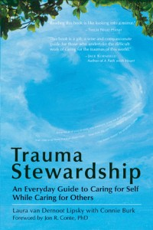
Trauma Stewardship
Author: Laura van Dernoot Lipsky

Slide 10
Keeping Tools Sharp

Slide 11
Types of relationships
Healthy
Unhealthy
Toxic

Slide 12
Institutional Trauma
The effects on a practitioner from overwhelming demands and expectations of supervisors, organizations, external regulatory systems, funders, and other external systems of care that are inflexible, inadequate, and/or non-responsive to the needs of clients being served
(adapted from Newell & MacNiell, 2010)

Slide 13
SOCIAL WORKER
CLIENT

Slide 14
PROGRAM
SOCIAL WORKER
CLIENT

Slide 15
AGENCY
PROGRAM
SOCIAL WORKER
CLIENT

Slide 16
COMMUNITY
AGENCY
PROGRAM
SOCIAL WORKER
CLIENT

Slide 17
STATE
COMMUNITY
AGENCY
PROGRAM
SOCIAL WORKER
CLIENT

Slide 18
FEDERAL
STATE
COMMUNITY
AGENCY
PROGRAM
SOCIAL WORKER
CLIENT

Slide 19
SOCIETY
FEDERAL
STATE
COMMUNITY
AGENCY
PROGRAM
SOCIAL WORKER
CLIENT

Slide 20
SOCIETY
FEDERAL
STATE
INSTITUTIONAL TRAUMA
COMMUNITY
AGENCY
PROGRAM
SOCIAL WORKER
VICARIOUS TRAUMA
CLIENT

Slide 21
Power and Control
Intimidation
Coercion
and Threats
Economic Abuse
Power
And
Control
Emotional Abuse
Privilege
Isolation
Minimizing, Denying, Blaming
Adapted from Workplace Bullying wheel - Anne-Marie Quigg – June 2011
Using Others

Slide 22
How to Keep Tools Sharp?
Self-Care Plan
Seek Support
Advocate

Slide 23
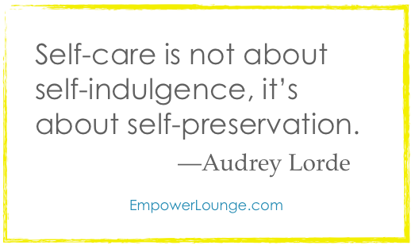
Self-Care and Wellness
Be intentional and purposeful about what you CAN control.
Re-define self-care as a unique experience.
Consider biopsychosocial-spiritual wellness.
Take a Break….

Slide 25
Seek Support
Just because we are helpers, doesn't mean we won't need help from other helpers for ourselves or our families.
The act of seeking counseling and professional help needs to be de-stigmatized for helpers, so appropriate help can be accessed as needed.

Slide 26
Advocacy and Empowerment
Brainstorm – How can social workers advocate within institutional trauma? What are the risks?
Problem solve – How do social workers take action in a collaborative way?
Action – What can you do to support, collaborate, educate, etc your colleagues/program/agency?

Slide 27
Summary
Institutional Trauma influences how social workers provide services, ultimately impacting how/if clients needs are met.
Social Workers are impacted by vicarious trauma and institutional trauma, making for a complicated balance to maintain wellness and self-care.
Within the barriers of institutional trauma, social workers can make a personal self-care plan, can seek support, and can advocate for themselves and their clients' needs.

Slide 28
References
Academy of Traumatology (2010). Standards of self care guidelines. Retrieved October 14, 2013 from www.greencross.org.
LaRowe, K. (2007). The care giving personality. Retrieved October 14, 2013 from www.compassion-fatigue.com.
LaRowe, K. (2007). The personal cost of care. Retrieved October 14, 2013 from www.compassion-fatigue.com.
Newell, J., & MacNeil, G. (2010). Professional burnout, vicarious trauma, secondary traumatic stress, and compassion fatigue: A review of theoretical terms, risk factors, and preventive methods for clinicians and researchers. Best Practices in Mental Health, 6(2), 57-68.
Tse, S. (2008). Self-care for health professionals: Addressing mind, body, and spirit. International Journal of Therapy and Rehabilitation, 15(6), 244.
van Dernoot Lipsky, L. & Burk, C. (2009). Trauma stewardship: A everyday guide to caring for self while caring for others. San Francisco: Berrett-Koehler, Inc.

