Slide 1
SECONDARY TRAUMATIC STRESS OF CHILD WELFARE WORKERS: A Qualitative Investigation Jennifer Cornish Genovese, LCSW, PhD
2015 Annual Power of Social Work Conference
Building Strong Communities, Collaborative Practice, and
Accountable Leadership: Social Work in Action
March 19-20, 2015 * Albany, NY

Slide 2
Introductions
Speaker
Audience
Ground Rules

Slide 3
Trauma
A distressing event that is outside the range of usual human experience. Trauma often involves a sense of intense fear, terror and helplessness.

Slide 4
Post-Traumatic Stress Disorder
(from the DSM-IV TM)
The person has been exposed to a traumatic event in which both of the following were present:

Slide 5
1.The person experienced, witnessed, or was confronted with an event or events that involved actual or threatened death or serious injury, or a threat to the physical integrity of self or others.

Slide 6
2. The person’s response involved intense fear, helplessness, or horror.
Note: in children, this may be expressed instead by disorganized or agitated behavior.

Slide 7
Post-Traumatic Stress Disorder
(from the DSM-V)
Exposure to actual or threatened death, serious injury, or sexual violence in one (or more of the following ways:

Slide 8
1. Directly experiencing the traumatic events(s).
2. Witnessing, in person, the event(s) as it occurred to others.

Slide 9
3. Learning that the traumatic event(s) occurred to a close family member or close friend. In cases of actual or threatened death of a family member or friend, the event(s) must have been violent or accidental.

Slide 10
4. Experiencing repeated or extreme exposure to aversive details of the traumatic event(s) (e.g., first responders collecting human remains; police officers repeatedly exposed to details of child abuse).
Note: Criterion A4 does not apply to exposure through electronic media, television, movies, or pictures, unless this exposure is work related.

Slide 11
Secondary Traumatic Stress
“The natural and consequent behaviors and emotions resulting from knowledge about a traumatizing event experienced by a significant other.

Slide 12
It is the stress resulting from helping or wanting to help a traumatized or suffering person.” (Figley, C., 1995)

Slide 13
“People can be traumatized without actually being physically harmed or threatened with harm. They can be traumatized simply by learning about the traumatic event.” (Figley, C., 1995).

Slide 14
Secondary Trauma can occur following the exposure to a single traumatic event.

Slide 15
Personal Symptoms of Secondary Traumatic Stress
Cognitive Symptoms
Emotional Symptoms
Behavioral Symptoms
Spiritual Symptoms
Interpersonal Symptoms
Physical Symptoms
(Yassan, 1995)

Slide 16
Physical Indicators
Headaches
Stomach Aches
Lethargy
Sleep Disturbance (e.g. nightmares, insomnia)
(www.ChildTrauma.org)

Slide 17
Personal Indicators
Self-Isolation
Cynicism
Mood swings
Irritability with Family Members
(www.ChildTrauma.org)

Slide 18
Professional Indicators
Performance of Job Tasks
Morale
Interpersonal Symptoms
Behavioral Symptoms
(Yassan, 1995)

Slide 19
Workplace Indicators
Avoidance of Certain Clients
Missed Appointments
Tardiness
Lack of Motivation
(www.ChildTrauma.org)

Slide 20
Contributors to the Development of Secondary Traumatic Stress

Slide 21
Caseload
Length of Employment
Level of Experience
Exposure to Graphic Accounts of Abuse
Insufficient Recovery Time Between Exposure

Slide 22
Work Environment
Isolation and Systemic Fragmentation
Lack of Supervision
Lack of Agency Resources
Current Life Stressors
Personal History of Trauma

Slide 23
Secondary Trauma: WHO IS AT RISK?
Persons at risk for developing Secondary Trauma have the responsibility for providing care to a person who has had some type of crisis.

Slide 24
Why are Child Welfare Workers at Increased Risk for Developing Secondary Traumatic Stress?

Slide 25
Child Welfare Workers work with children: the most vulnerable members of our society.

Slide 26
Goals of Child Protective Services
1) to assess the safety of children
2) to intervene to protect children from harm

Slide 27
3) to strengthen the ability of families to protect their children
4) to provide either a reunification or an alternative, safe family for the child

Slide 28
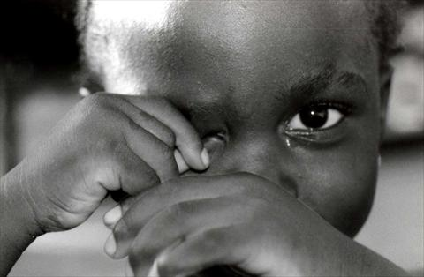
In 2013, 3.5 million reports of child abuse and maltreatment were received by Child Protective Agencies across the United States.
(US Dept. of Health and
Human Services, 2013)

Slide 29
In the United States, over 30,000 Child Welfare Workers were responsible for investigating child abuse reports and assessing the ongoing safety of children.

Slide 30
Child welfare workers are at the frontline of child abuse investigations.

Slide 31
4 Major Types of Child Abuse
Neglect
Physical Abuse
Psychological Maltreatment
Sexual Abuse
These may occur separately or in combination

Slide 32
Types of Child Abuse

Slide 33
6.4 million children were at the center of these child abuse investigations nationwide.

Slide 34
In 2013, 1,530 children died of child abuse and neglect, at a rate of 2.04 children per 100,00 children in the national population.

Slide 35
A report of child abuse is made every ten seconds.

Slide 36
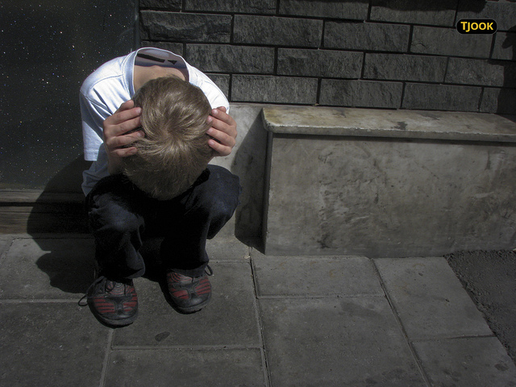
As a result of their work, child welfare workers are frequently exposed to the extreme cruelty and violence that has been directed towards children.

Slide 37
Repeated exposure to the trauma of others can lead to the development of secondary traumatic stress for child welfare workers.

Slide 38
Purpose of This Study
Previous research on Secondary Traumatic Stress has focused primarily on the experiences of:

Slide 39
Psychotherapists
Police Officers
Firefighters
First Responders
Emergency Medical Technicians

Slide 40
There is a paucity of research on the effects of child abuse on the Child Welfare Workers who investigate allegations of abuse and work with victims.

Slide 41
The limited research on secondary traumatic stress and child welfare workers has not focused solely on child welfare workers.

Slide 42
Previous Studies on Secondary Traumatic Stress & Child Welfare Workers Have Included:
Administrators
Supervisors
Child Welfare Workers
Support Staff

Slide 43
Contribution to the Field
This study adds to existing research by focusing solely on child welfare workers.

Slide 44
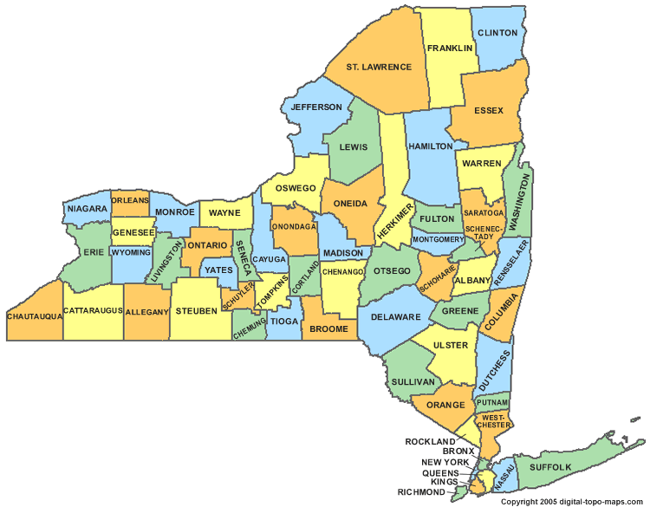
New York State Statistics (2012 estimate)
Population: 19,570,261
Residing in 62 counties

Slide 45
Three Central New York Counties were included in this study.

Slide 46
2012 NYS Census Data, Per County
 | Population 2012 | County Size (in square miles) | Persons per Square Mile | Race
 |  |  |  | Caucasian | African American | Asian
County 1 | 49,474 | 502 sq. miles | 99 | 95% | 1.5% | .8%
County 2 | 73,382 | 662 sq. miles | 112 | 95% | 1.8% | .8%
County 3 | 108,519 | 662 sq. miles | 168 | 94% | 2.3% | 1%

Slide 47
Recruitment
Letters were sent to three Commissioners of Departments of Social Service (DSS) providing an overview of the study

Slide 48
I requested permission to interview staff:
In a confidential setting at the work site
During work hours

Slide 49
Procedure
E-mails were sent to the DSS secretaries in 3 counties
The e-mails were forwarded to all child welfare workers, informing them of the study and asking them to participate

Slide 50
Child welfare workers who chose to participate in the study responded via e-mail
Appointments were scheduled via e-mail for face-to-face interviews

Slide 51
Participation Requirements
Voluntary Participants
Confidential, on-site location
Child welfare workers would be able to participate during work hours

Slide 52
Measures
Demographic Questionnaire
Semi-Structured Interview, approximately 1 ½ hours in length

Slide 53
Age of Participants

Slide 54
Gender of Participants

Slide 55
Level of Education of Participants

Slide 56
Years of Experience of Participants
Notes:
1-5 years= 10; 11-15 years= 3; 16+ years= 3

Slide 57
Questions Posed:
Are child welfare workers experiencing secondary traumatic stress?
If so, why?

Slide 58
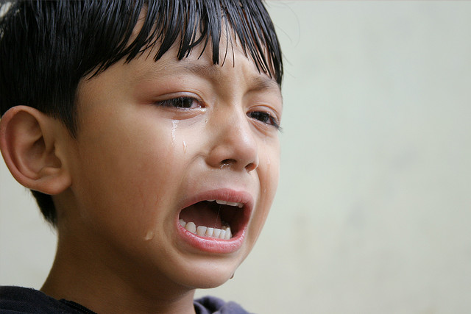
Does exposure to child abuse and neglect place child welfare workers at risk for developing secondary traumatic stress?

Slide 59
Does exposure to alleged child abusers place child welfare workers at risk for developing secondary traumatic stress?

Slide 60
Do co-workers provide a source of support in the workplace, or are they a source of work stress?
Do supervisors provide a source of support in the workplace, or are they a source of work stress?

Slide 61
What are the potential physical and emotional consequences of child welfare work?

Slide 62
Analytic Approach
Interviews were transcribed using Dragon Naturally Speaking voice recognition software, Version 11.

Slide 63
Transcribing the data and reviewing the transcripts for accuracy was an essential part of the research process.

Slide 64
NVivo 9
Transcripts were uploaded into the qualitative data analysis software program, NVivo 9.

Slide 65
NVivo 9 is a qualitative data analysis program that supports the user to manage data, manage ideas, query data, graphically model data, and report data.

Slide 66
Coding
Coding is a method of working with data that allows the researcher to take transcriptions, and verbatim accounts from participants, and classify them.

Slide 67
Rigor & Trustworthiness
Four strategies utilized for enhancing the rigor and trustworthiness of this research:
Prolonged engagement
Triangulation
Peer debriefing and support
Member checking

Slide 68
Focus-Group: County 2
The focus group provided an opportunity for participant feedback or “member checking” to assure interpretive validity.

Slide 69
The focus group in County 2 confirmed the three predominant themes presented by the research participants of the study.

Slide 70
Results
3 Central Themes Emerged:
1. The Unpredictability of Child Welfare Work
2. Relationships with Others
3. Consequences of Child Welfare Work

Slide 71
Physical Consequences
Sleep Disturbance 100%
Health Related Symptoms 94 %
Stomach Distress
Chronic Diarrhea
Headaches/Migraines
High Blood Pressure

Slide 72
Significant Weight Gain
(20 – 50 lbs)
Agitation and Irritability
Frequent Illness

Slide 73
Conclusions
The question answered by this study was not if child welfare workers were experiencing secondary traumatic stress, but why are they experiencing secondary traumatic stress?

Slide 74
Despite being exposed to unspeakable cases of child abuse and neglect, the child welfare workers in this study indicated that this exposure alone did not result in the development of secondary traumatic stress.

Slide 75
Why?
Lack of support in the workplace from supervisors and administrators

Slide 76
Fear of blame and retribution if something goes wrong on their caseload.
Inconsistent messages from supervisors

Slide 77
While the child welfare workers admitted that their exposure to abused and maltreated children did have a deleterious impact on them, overall they viewed that as secondary to the effects produced by lack of support received by supervisors and administrators.

Slide 78
Implications for Practice
Education and Training for All Staff
Administrators
Supervisors
Child Welfare Workers
Support Staff

Slide 79
Recruitment and Training for Supervisors
Focus on Supervisory Qualifications
Provide On-Going Supervisory Training

Slide 80
Limitations
Self-Report
Limited Sample
Predominantly female participants
No racial diversity
2 out of 3 counties were rural
No urban county representation

Slide 81
The study did not address a previous history of trauma on the part of the child welfare workers.

Slide 82
Recommendations
Further research should focus on the role the supervisor plays in the development of secondary traumatic stress and child welfare workers.

Slide 83
Research on the prevention and intervention of secondary traumatic stress would be a valuable addition to the literature.

Slide 84
It would be beneficial to examine whether or not supervisors experience secondary traumatic stress and if so, investigate the origin of their stress.

Slide 85
As one child welfare worker poignantly revealed: “I think we could deal with anything if we just had the support we needed.”

Slide 86
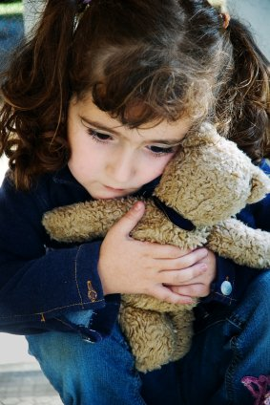
Future research should focus on developing ways to support child welfare workers and supervisors so they can continue the difficult work of caring for abused children and their families.

